Slide 1
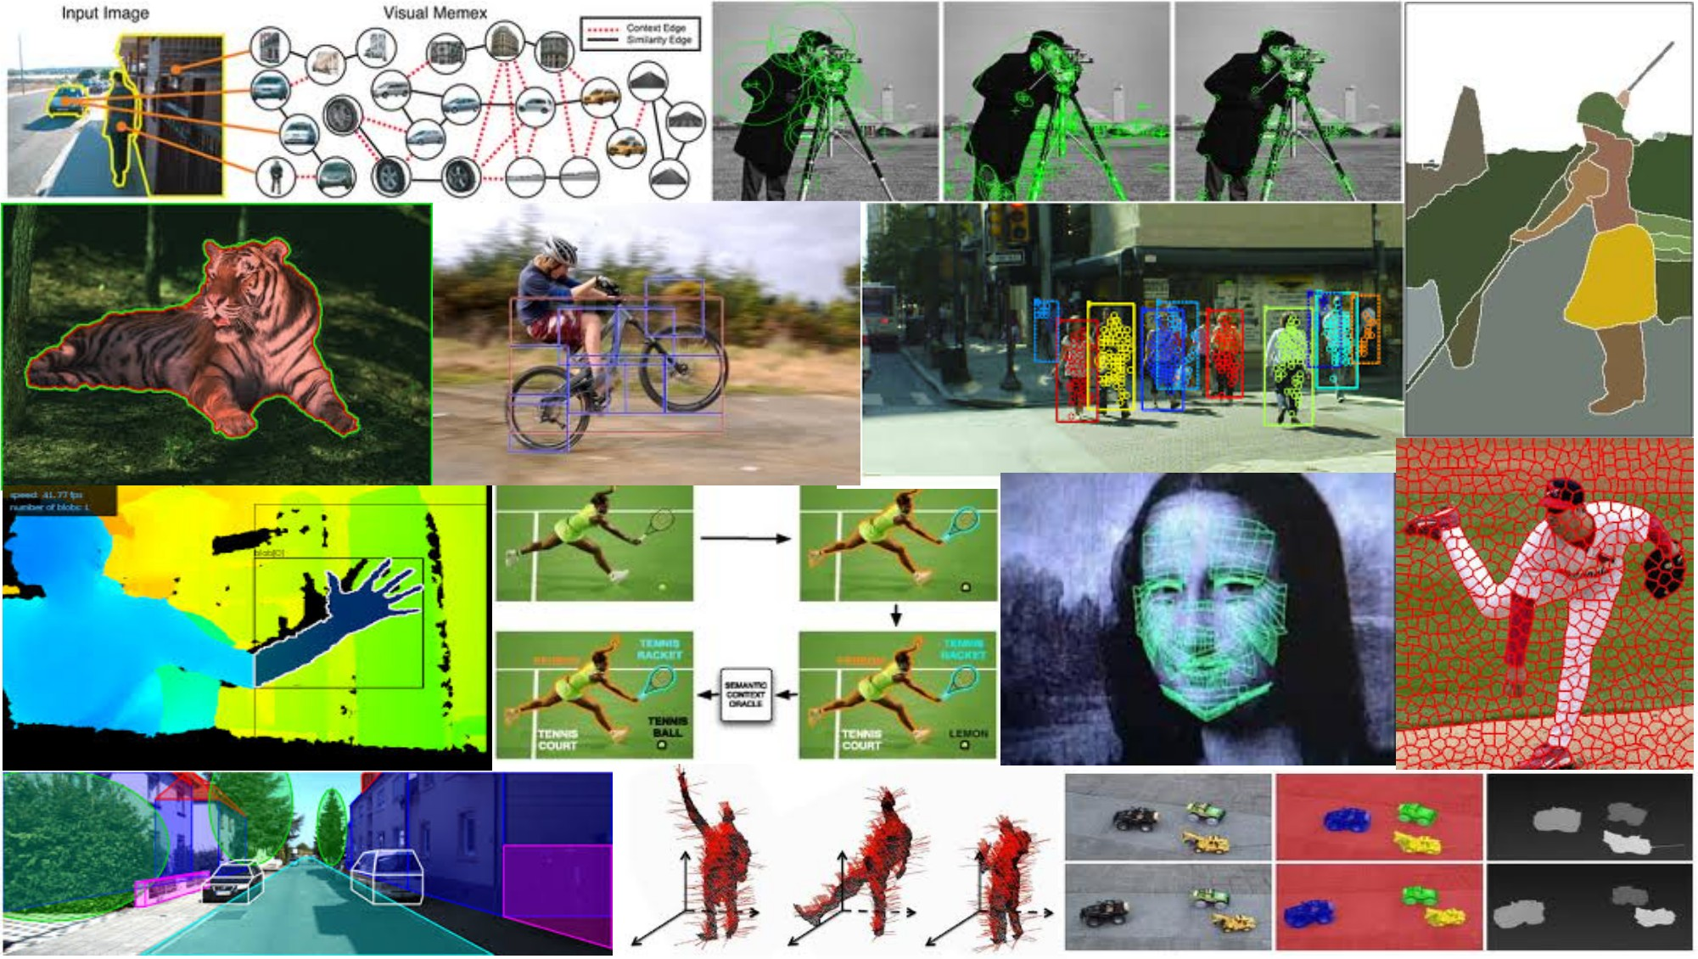
Fitting: Deformable contours April 26th, 2018
Yong Jae Lee
UC Davis

Slide 2
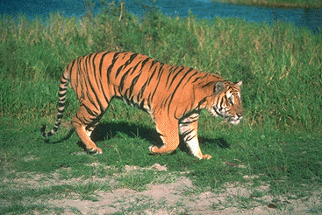
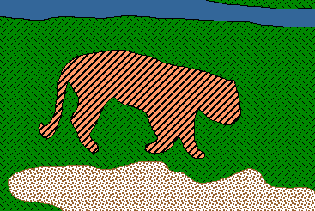
Recap so far: Grouping and Fitting
Goal: move from array of pixel values (or filter outputs) to a collection of regions, objects, and shapes.
Slide credit: Kristen Grauman

Slide 3
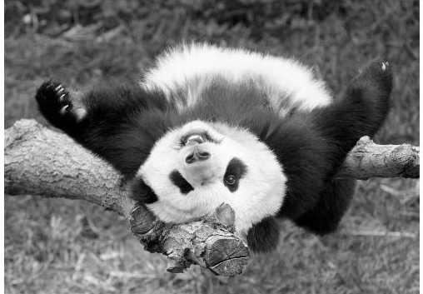
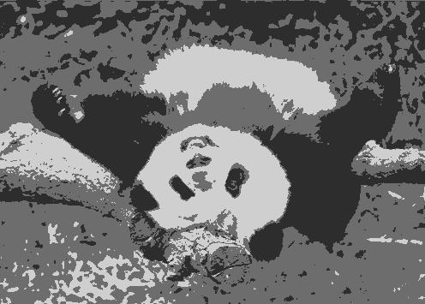

Grouping: Pixels vs. regions
By grouping pixels based on Gestalt-inspired attributes, we can map the pixels into a set of regions.
Each region is consistent according to the features and similarity metric we used to do the clustering.
image
clusters on intensity
image
clusters on color
Kristen Grauman

Slide 4
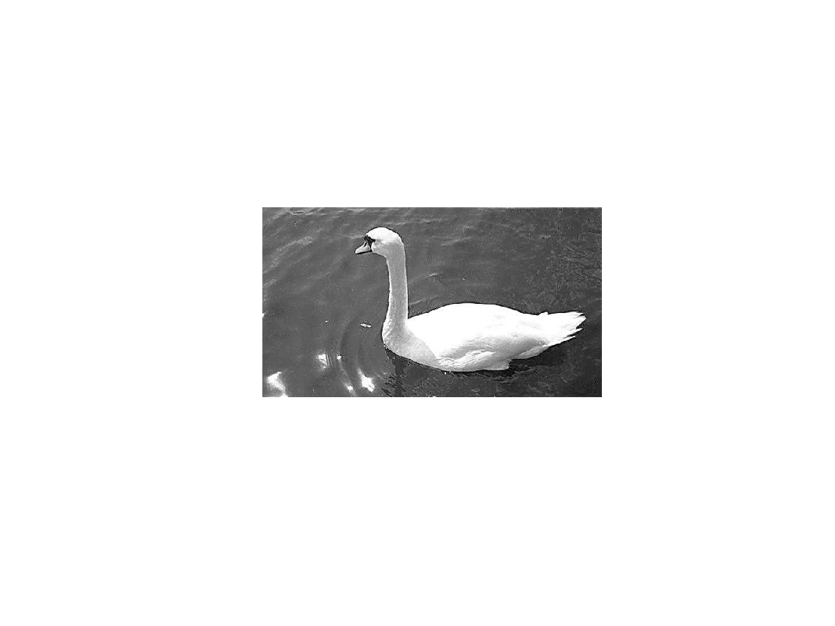
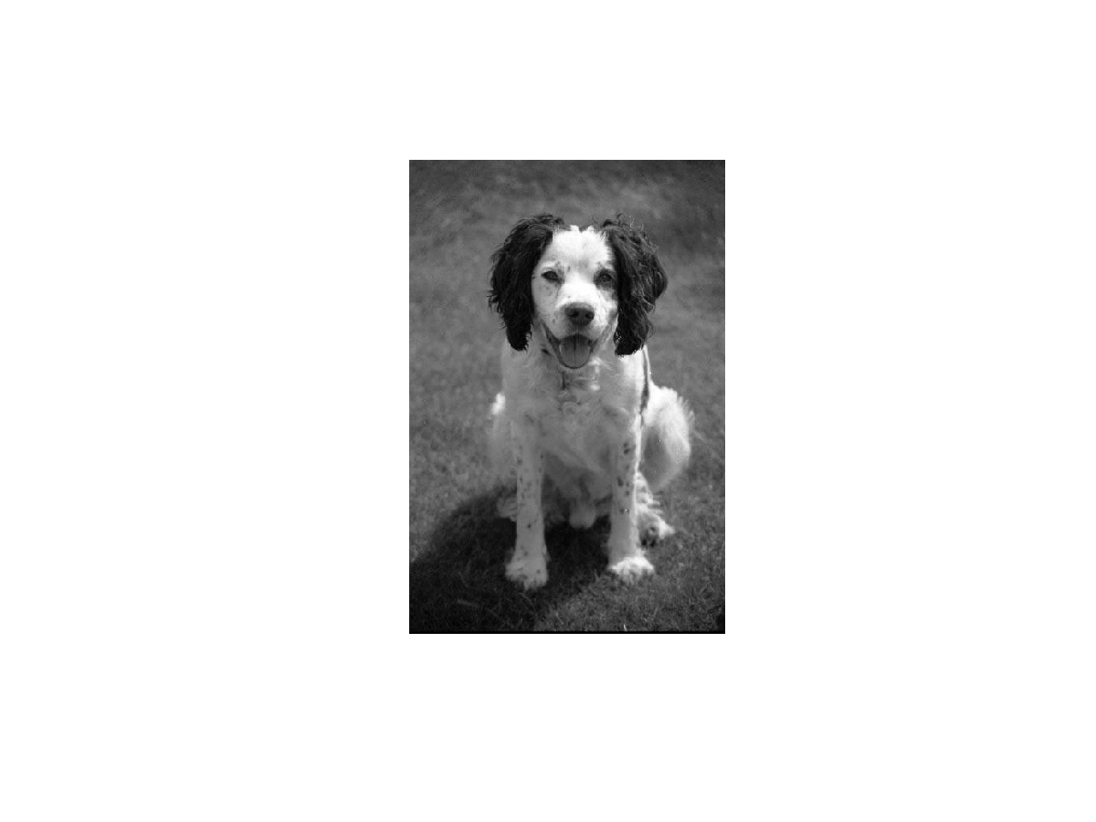
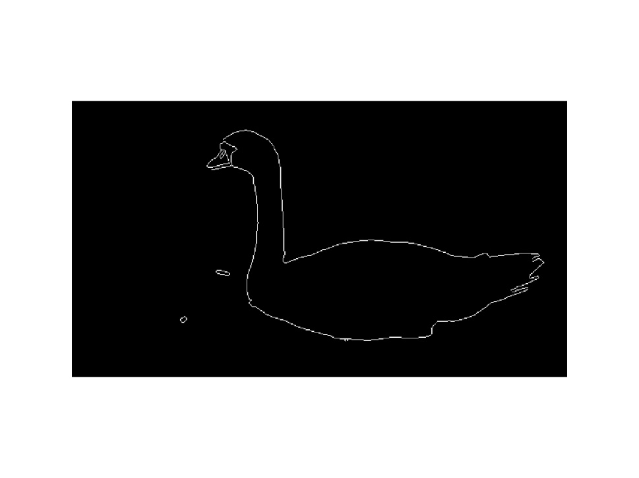
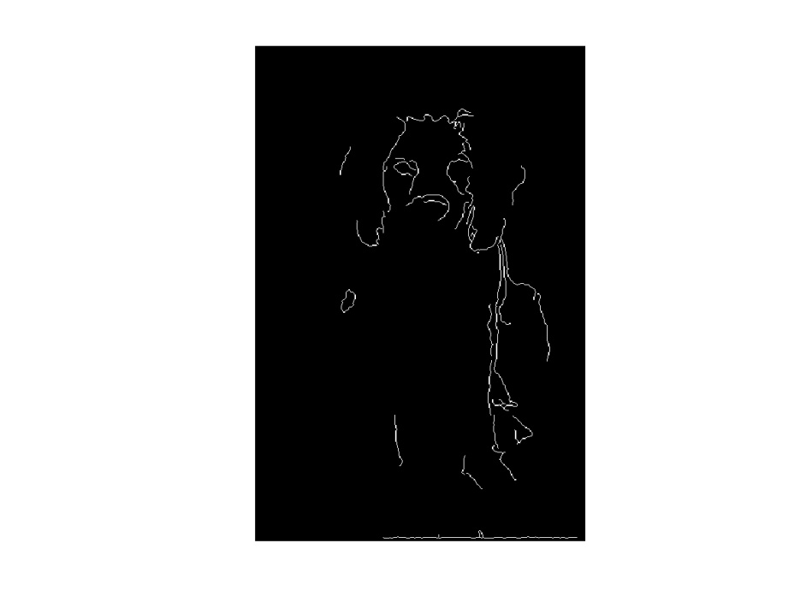
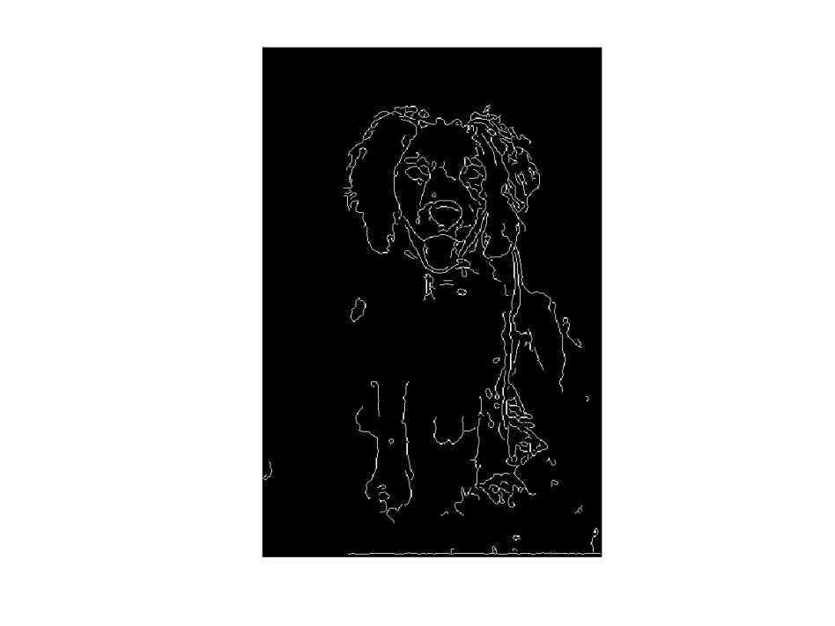
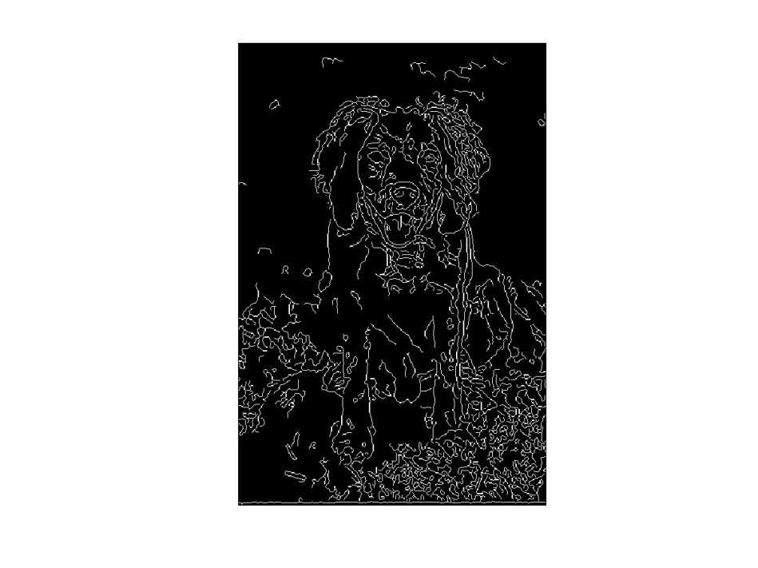
Fitting: Edges vs. boundaries
Edges useful signal to indicate occluding boundaries, shape.
Here the raw edge output is not so bad…
…but quite often boundaries of interest are fragmented, and we have extra “clutter” edge points.
Images from D. Jacobs

Slide 5
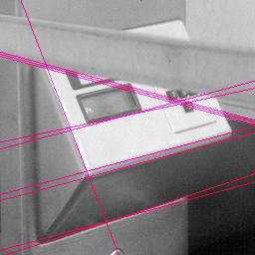
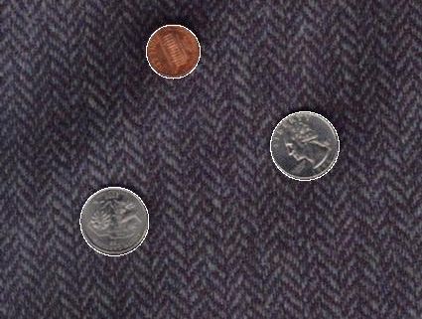
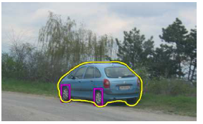
Fitting: Edges vs. boundaries
Given a model of interest, we can overcome some of the missing and noisy edges using fitting techniques.
With voting methods like the Hough transform, detected points vote on possible model parameters.
Kristen Grauman

Slide 6
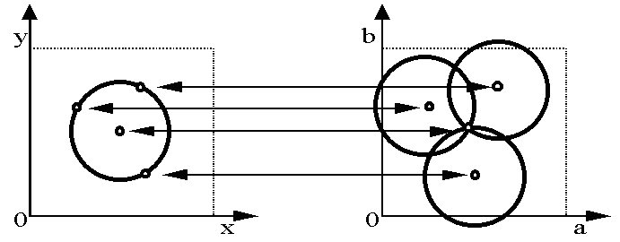
Voting with Hough transform
Hough transform for fitting lines, circles, arbitrary shapes
b
y
(x₁, y₁)
y₀
(x₀, y₀)
x₀
x
m
image space
Hough space
In all cases, we knew the explicit model to fit.
Kristen Grauman

Slide 7
Today
Fitting an arbitrary shape with “active” deformable contours

Slide 8
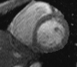
Deformable contours
a.k.a. active contours, snakes
Given: initial contour (model) near desired object
Slide credit: Kristen Grauman
[Snakes: Active contour models, Kass, Witkin, & Terzopoulos, ICCV1987]
Figure credit: Yuri Boykov

Slide 9
Deformable contours
a.k.a. active contours, snakes
Given: initial contour (model) near desired object
Goal: evolve the contour to fit exact object boundary
Main idea: elastic band is iteratively adjusted so as to
be near image positions with high gradients, and
satisfy shape “preferences” or contour priors
Slide credit: Kristen Grauman
[Snakes: Active contour models, Kass, Witkin, & Terzopoulos, ICCV1987]
Figure credit: Yuri Boykov

Slide 10
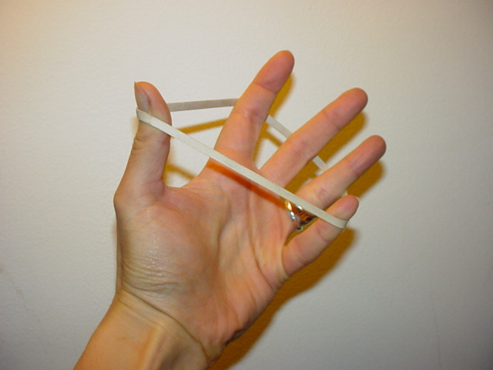
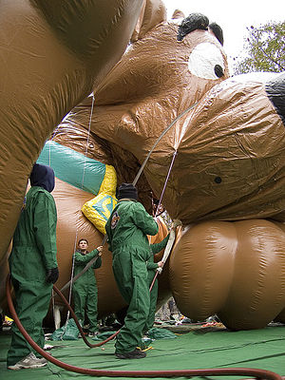
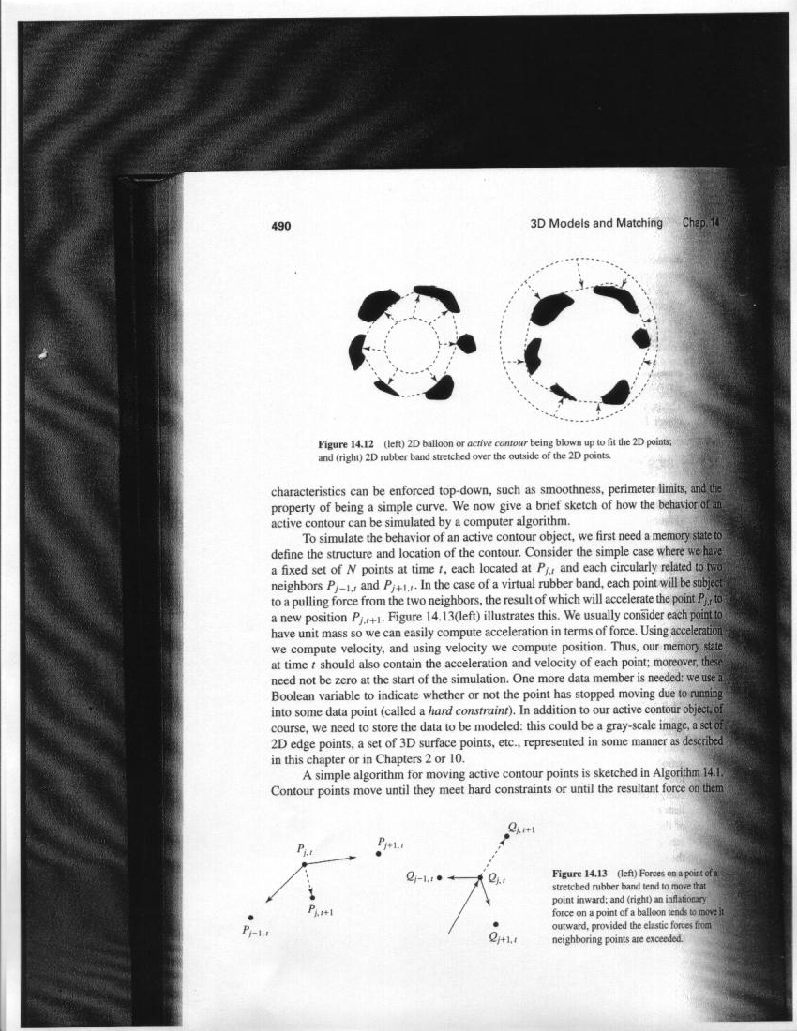
Deformable contours: intuition
Image from http://www.healthline.com/blogs/exercise_fitness/uploaded_images/HandBand2-795868.JPG

Slide 11
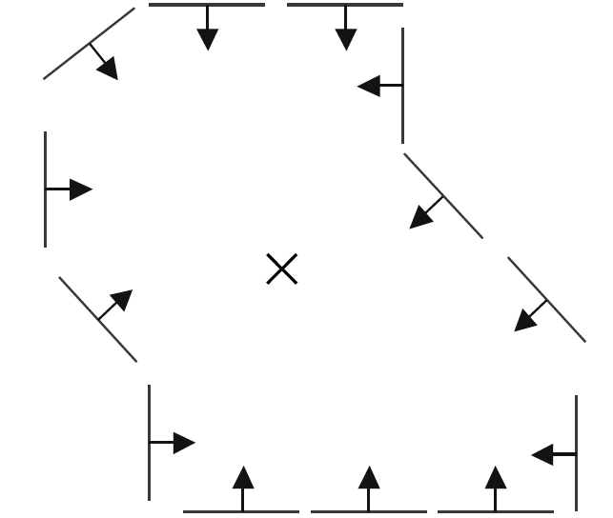
Deformable contours vs. Hough
Like generalized Hough transform, useful for shape fitting; but
initial
intermediate
final
Hough
Rigid model shape
Single voting pass can detect multiple instances
Deformable contours
Prior on shape types, but shape iteratively adjusted (deforms)
Requires initialization nearby
One optimization “pass” to fit a single contour
Kristen Grauman

Slide 12
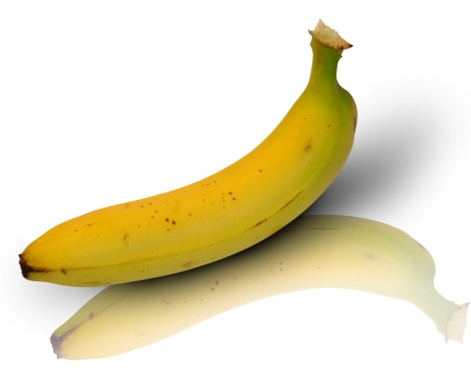
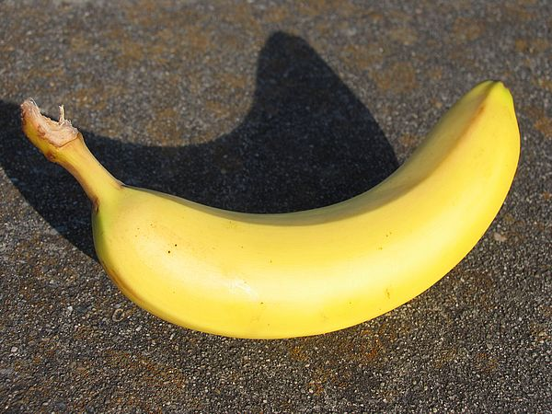
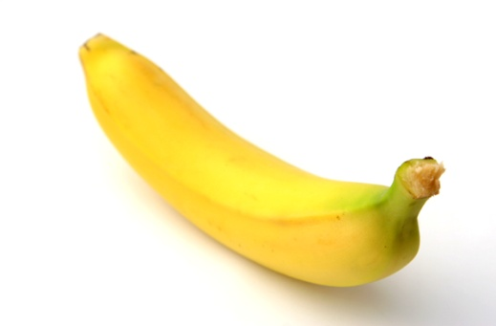
Why do we want to fit deformable shapes?
Some objects have similar basic form but some variety in the contour shape.
Kristen Grauman

Slide 13
Why do we want to fit deformable shapes?
Non-rigid, deformable objects can change their shape over time, e.g. lips, hands…
Figure from Kass et al. 1987

Slide 14
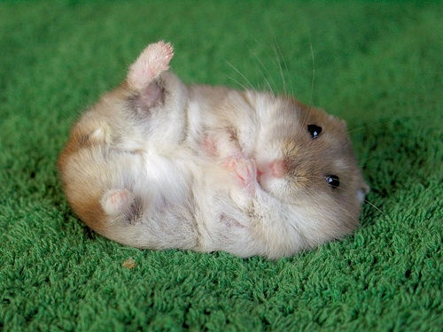
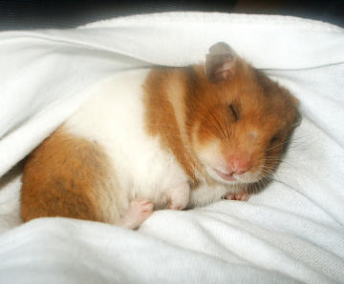
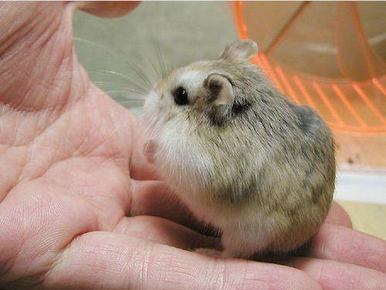
Why do we want to fit deformable shapes?
Non-rigid, deformable objects can change their shape over time, e.g. lips, hands…
Kristen Grauman

Slide 15
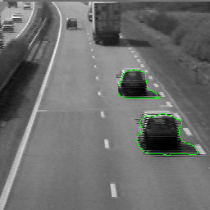
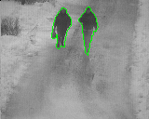
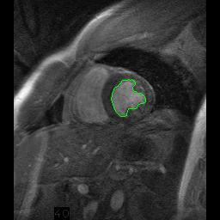
Why do we want to fit deformable shapes?
Non-rigid, deformable objects can change their shape over time.
Figure credit: Julien Jomier
Notes:
heart

Slide 16
Aspects we need to consider
Representation of the contours
Defining the energy functions
External
Internal
Minimizing the energy function
Extensions:
Tracking
Interactive segmentation
Kristen Grauman

Slide 17
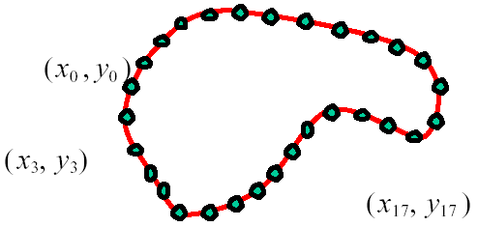
Representation
We’ll consider a discrete representation of the contour, consisting of a list of 2d point positions (“vertices”).
for
At each iteration, we’ll have the option to move each vertex to another nearby location (“state”).
Kristen Grauman

Slide 18
Fitting deformable contours
How should we adjust the current contour to form the new contour at each iteration?
Define a cost function (“energy” function) that says how good a candidate configuration is.
Seek next configuration that minimizes that cost function.
initial
intermediate
final
Slide credit: Kristen Grauman

Slide 19
Energy function
The total energy (cost) of the current snake is defined as:
Internal energy: encourage prior shape preferences: e.g., smoothness, elasticity, particular known shape.
External energy (“image” energy): encourage contour to fit on places where image structures exist, e.g., edges.
A good fit between the current deformable contour and the target shape in the image will yield a low energy.
Slide credit: Kristen Grauman

Slide 20
External energy: intuition
Measure how well the curve matches the image data
“Attract” the curve toward different image features
Edges, lines, texture gradient, etc.
Slide credit: Kristen Grauman

Slide 21

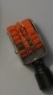
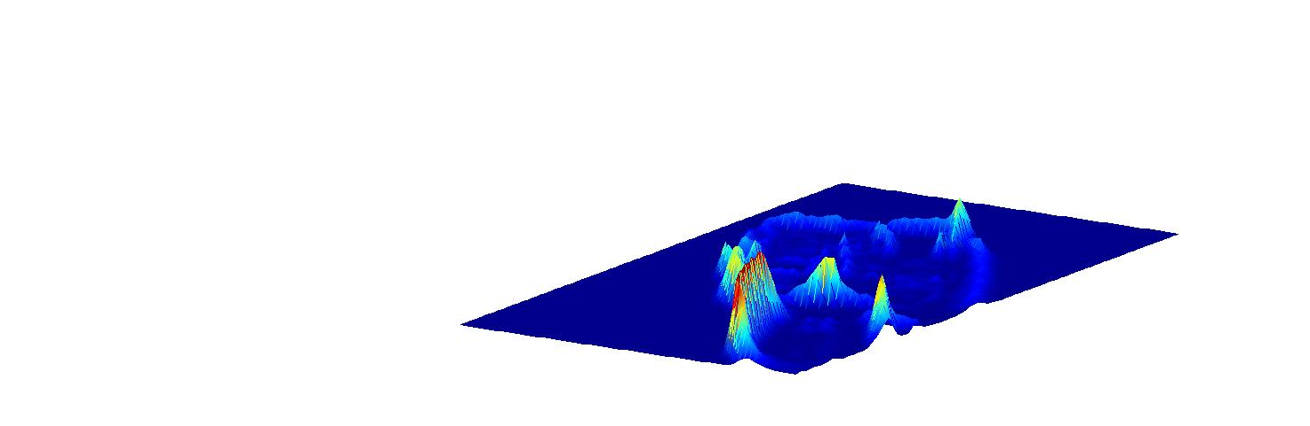
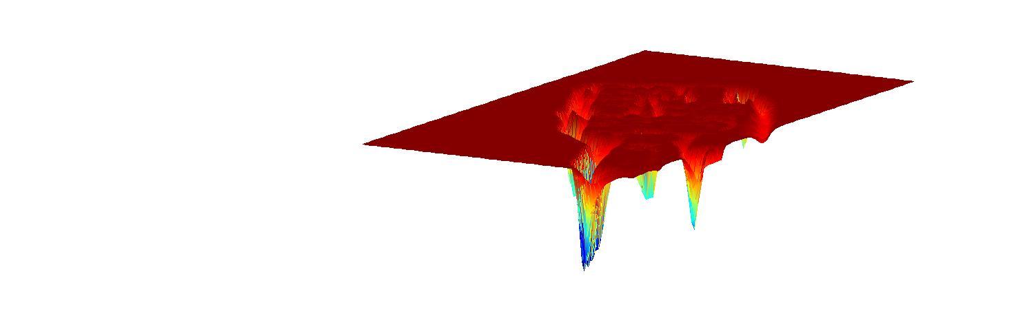
External image energy
How do edges affect “snap” of rubber band?
Think of external energy from image as gravitational pull towards areas of high contrast
Magnitude of gradient
- (Magnitude of gradient)
Slide credit: Kristen Grauman

Slide 22
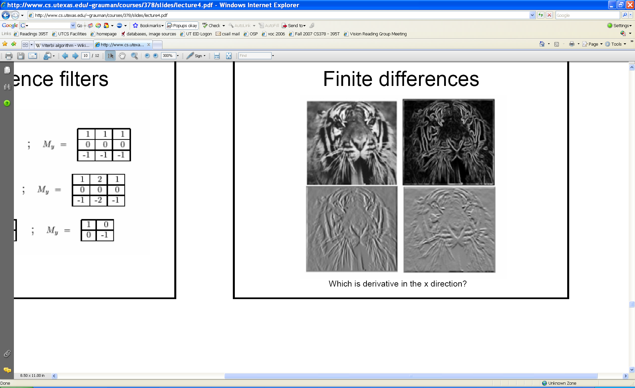
External image energy
Gradient images and
External energy at a point on the curve is:
External energy for the whole curve:
Kristen Grauman

Slide 23

Internal energy: intuition
What are the underlying boundaries in this fragmented edge image?
And in this one?
Kristen Grauman
Notes:
True object boundaries?

Slide 24
Internal energy: intuition
A priori, we want to favor smooth shapes, contours with low curvature, contours similar to a known shape, etc. to balance what is actually observed (i.e., in the gradient image).
Kristen Grauman

Slide 25

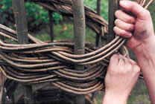
Internal energy
For a continuous curve, a common internal energy term is the “bending energy”.
At some point v(s) on the curve, this is:
Tension,
Elasticity
Stiffness,
Curvature
Kristen Grauman

Slide 26
Internal energy
For our discrete representation,
Internal energy for the whole curve:
…
Note these are derivatives relative to spatial position.
Why do these reflect tension and curvature?

Slide 27
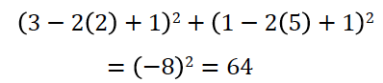
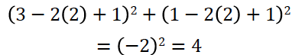
Example: compare curvature
(2,5)
(2,2)
(3,1)
(1,1)
(3,1)
(1,1)
Kristen Grauman

Slide 28
Penalizing elasticity
Current elastic energy definition:
What is the possible problem with this definition?
Kristen Grauman

Slide 29
Penalizing elasticity
Current elastic energy definition:
Instead:
where d is the average distance between pairs of points – updated at each iteration.

Slide 30
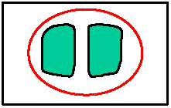
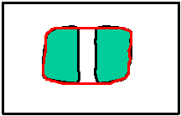
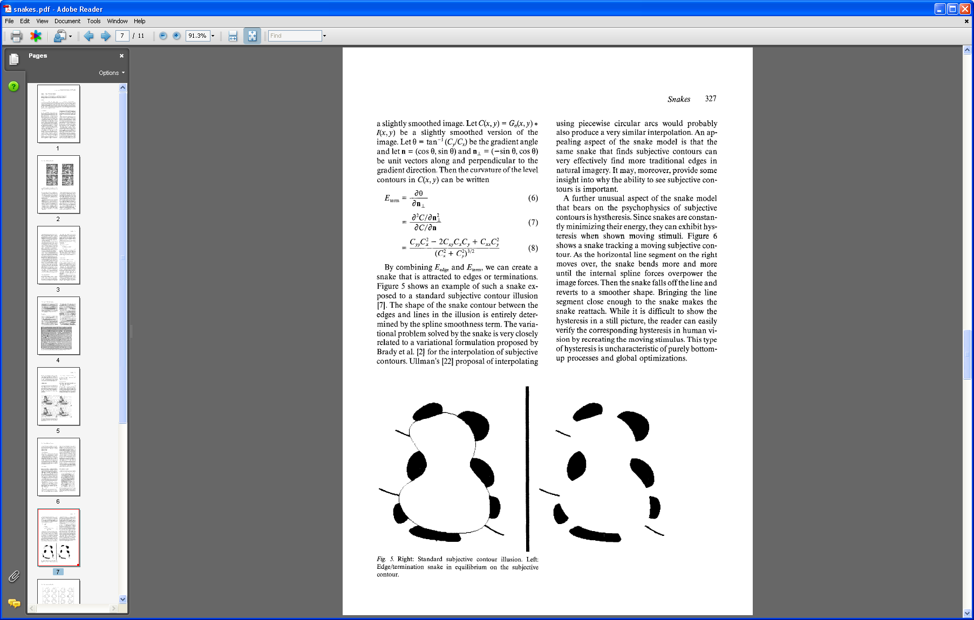
Dealing with missing data
The preferences for low-curvature, smoothness help deal with missing data:
Illusory contours found!
[Figure from Kass et al. 1987]
Slide credit: Kristen Grauman

Slide 31
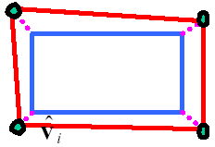
Extending the internal energy: capture shape prior
If object is some smooth variation on a known shape, we can use a term that will penalize deviation from that shape:
where are the points of the known shape.
Fig from Y. Boykov

Slide 32
Total energy: function of the weights

Slide 33
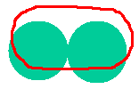


Total energy: function of the weights
e.g., weight controls the penalty for internal elasticity
large
medium
small
Slide credit: Kristen Grauman
Fig from Y. Boykov

Slide 34
Recap: deformable contour
A simple elastic snake is defined by:
A set of n points,
An internal energy term (tension, bending, plus optional shape prior)
An external energy term (gradient-based)
To use to segment an object:
Initialize in the vicinity of the object
Modify the points to minimize the total energy
Kristen Grauman

Slide 35
Energy minimization
Several algorithms have been proposed to fit deformable contours.
We’ll look at two:
Greedy search
Dynamic programming
Slide credit: Kristen Grauman

Slide 36
Energy minimization: greedy
For each point, search window around it and move to where energy function is minimal
Typical window size, e.g., 3 x 3 pixels
Stop when predefined number of points have not changed in last iteration, or after max number of iterations
Note:
Convergence not guaranteed
Need decent initialization
Kristen Grauman

Slide 37
Energy minimization
Several algorithms have been proposed to fit deformable contours.
We’ll look at two:
Greedy search
Dynamic programming
Slide credit: Kristen Grauman

Slide 38
Energy minimization: dynamic programming
With this form of the energy function, we can minimize using dynamic programming, with the Viterbi algorithm.
Iterate until optimal position for each point is the center of the box, i.e., the snake is optimal in the local search space constrained by boxes.
Fig from Y. Boykov
[Amini, Weymouth, Jain, 1990]
Notes:
The main idea behind dynamic programming is to compute the solution of a problem by combining solutions of subproblems

Slide 39
Energy minimization: dynamic programming
Possible because snake energy can be rewritten as a sum of pair-wise interaction potentials:

Slide 40
Snake energy: pair-wise interactions
Re-writing the above with :
where
Kristen Grauman

Slide 41
Viterbi algorithm
for each possible position (state) of vertex, find cost of optimal path arriving there, and optimal position of predecessor.
backtrack from best state for last vertex.
vertices
states
1
2
…
m
Complexity:
vs. brute force search ____?
Example adapted from Y. Boykov
Notes:
m^n

Slide 42
Energy minimization: dynamic programming
With this form of the energy function, we can minimize using dynamic programming, with the Viterbi algorithm.
Iterate until optimal position for each point is the center of the box, i.e., the snake is optimal in the local search space constrained by boxes.
Fig from Y. Boykov
Slide credit: Kristen Grauman
[Amini, Weymouth, Jain, 1990]

Slide 43
Energy minimization: dynamic programming
DP can be applied to optimize an open ended snake
For a closed snake, a “loop” is introduced into the total energy.
Work around:
Fix v₁ and solve for rest.
Fix an intermediate node at its position found in (1), solve for rest.
Slide credit: Kristen Grauman
Notes:
Work around can be iterated (v1 position updated each time)

Slide 44
Aspects we need to consider
Representation of the contours
Defining the energy functions
External
Internal
Minimizing the energy function
Extensions:
Tracking
Interactive segmentation
Slide credit: Kristen Grauman

Slide 45
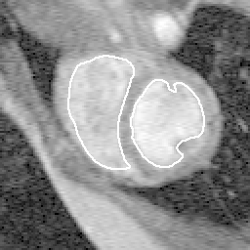
Tracking via deformable contours
Use final contour/model extracted at frame t as an initial solution for frame t+1
Evolve initial contour to fit exact object boundary at frame t+1
Repeat, initializing with most recent frame.
Tracking Heart Ventricles
(multiple frames)
Kristen Grauman

Slide 46
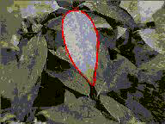

Tracking via deformable contours
Visual Dynamics Group, Dept. Engineering Science, University of Oxford.
Applications:
Traffic monitoring
Human-computer interaction
Animation
Surveillance
Computer assisted diagnosis in medical imaging
Kristen Grauman
Notes:
http://www.robots.ox.ac.uk/~vdg/dynamics.html
Tracked facial motions drive input channels to a cartoon cat, programmed with some exaggeration of expression

Slide 47
Limitations
May over-smooth the boundary
Cannot follow topological changes of objects
Slide credit: Kristen Grauman

Slide 48
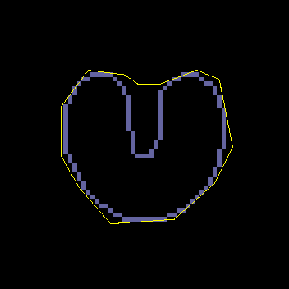
Limitations
External energy: snake does not really “see” object boundaries in the image unless it gets very close to it.
image gradients
are large only directly on the boundary

Slide 49


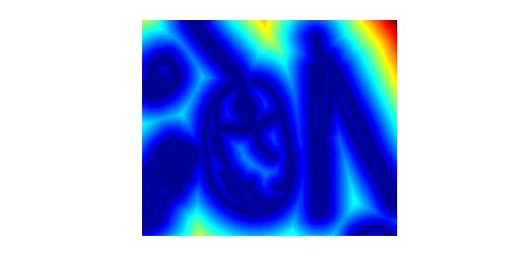

Distance transform
External image can instead be taken from the distance transform of the edge image.
original
-gradient
distance transform
Value at (x,y) tells how far that position is from the nearest edge point (or other binary mage structure)
edges
Kristen Grauman

Slide 50
Deformable contours: pros and cons
Pros:
Useful to track and fit non-rigid shapes
Contour remains connected
Possible to fill in “illusory” contours
Flexibility in how energy function is defined, weighted
Cons:
Must have decent initialization near true boundary, may get stuck in local minimum
Hyper-parameters of energy function must be set well

Slide 51
Summary
Deformable shapes and active contours are useful for
Segmentation: fit or “snap” to boundary in image
Tracking: previous frame’s estimate serves to initialize the next
Fitting active contours:
Define terms to encourage certain shapes, smoothness, low curvature, push/pulls, …
Use weights to control relative influence of each component cost
Can optimize snakes with Viterbi algorithm

Slide 52
Questions?
See you Tuesday!

